Slide 1
5th Workshop on Reconfigurable Computing for Machine Learning
Organisers:
Christos Bouganis, Imperial College London
Theocharis Theocharides, University of Cyprus
Christos Kyrkou, KIOS, University of Cyprus
Nele Mentens, KU Leuven, Leuven
Marco Domenico Santambrogio, Politecnico di Milano

Slide 2
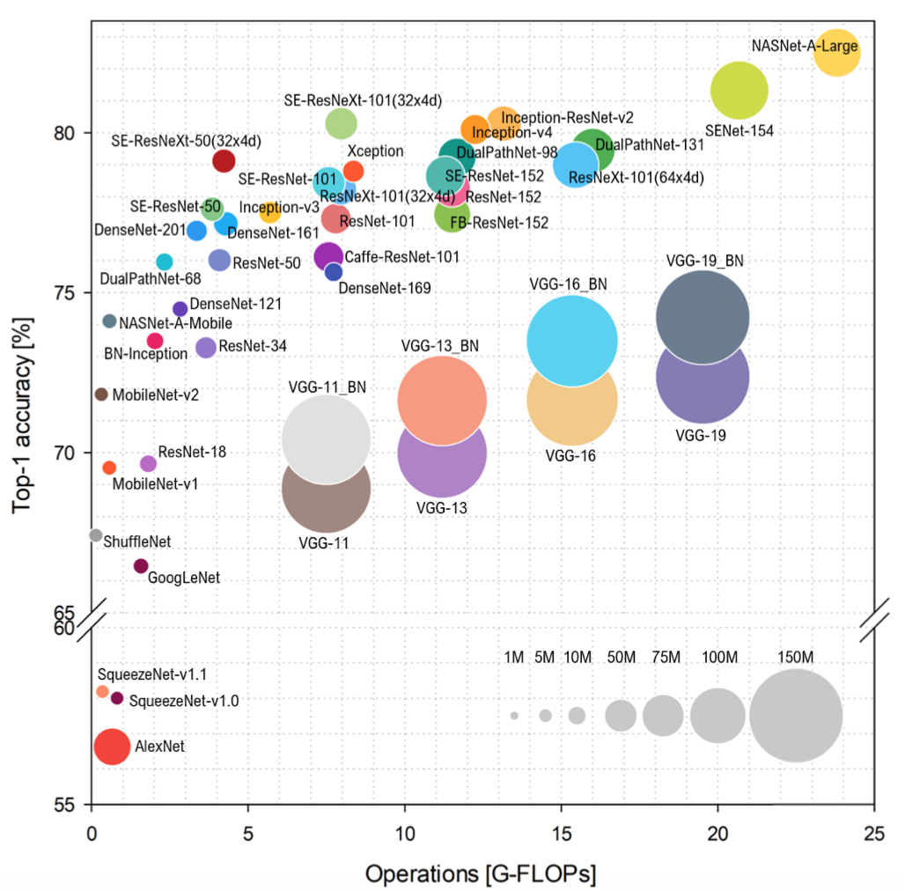
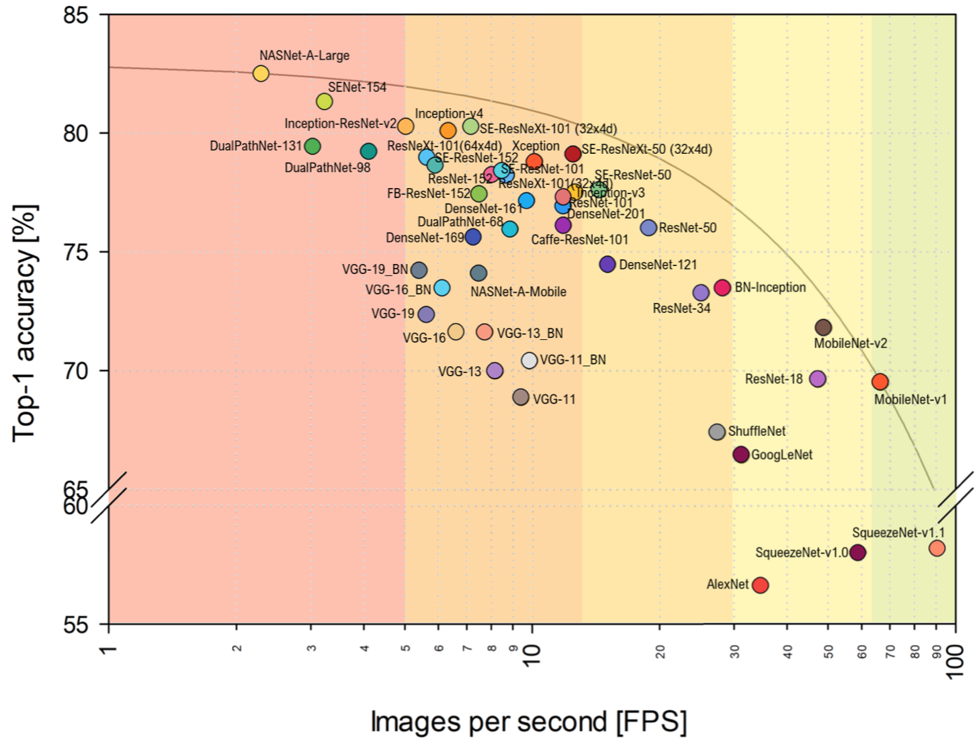
Deep learning evolution
S. Bianco, R. Cadene, L. Celona and P. Napoletano, "Benchmark Analysis of Representative Deep Neural Network Architectures," in IEEE Access, vol. 6, pp. 64270-64277, 2018, doi: 10.1109/ACCESS.2018.2877890.

Slide 3
Reconfigurable computing and ML
Mapping CNN to FPGAs
New structures in modern networks
Focus on other types: RNNs, LSTMs, Transformers, 3D networks, Early exit networks, …
Approximations easily accommodated in the DNN models
Numerical, Quantisation, Retraining, Binary NN,,…
Low power designs for IoT applications

Slide 4
Drive
Need for Performance and Efficiency
Solution:
Custom solutions
Repurpose hardware to the task
Challenges:
Design of the solution
Portability
….

Slide 5
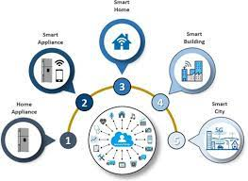
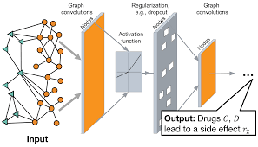
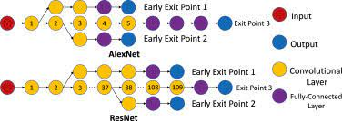
Topics to be covered
Optimisation of RNN and Probabilistic networks
Design of Reconfigurable Computing Systems for Smart IoT Applications
Early exit design methodologies
Accelerating Graph Neural Networks using FPGAs
Machine Learning and Side-channel Analysis

Slide 6
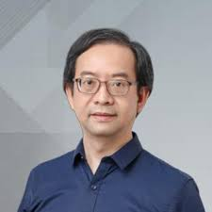
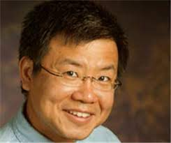
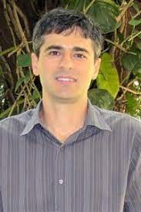
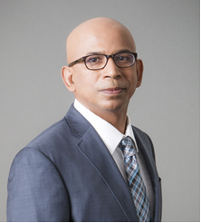
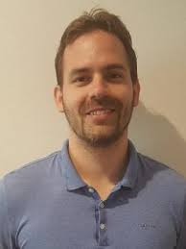
Programme
Time (CEST) | Speaker
14:30-14:40 | Introduction
14:40-15:20 | Prof. Wayne Luk, Imperial College London
15:20-16:00 | Prof. Deming Chen, Univ of Illinois, Urbana-Champaign
16:00-16:10 | Coffee break
16:10:16:50 | Prof. Vanderlei Bonato, The University of Sao Paulo
16:50-17:30 | Prof. Viktor Prasanna, University of Southern California
17:30-18:10 | Prof. Stjepan Picek, TU Delft
18:10-18:15 | Closing remarks
Prof. Luk
Prof. Chen
Prof. Bonato
Prof. Prasanna
Prof. Stjepan

Slide 7
Logistics
35 min presentations (including 5 min for questions)
Q&A: Please use the Q&A window to post your questions.
The presentations will be available through RCML’s website.

